Slide 1
Intro to Statistics
August 25, 2018

Slide 2
What is the “Measures of Central Tendency”?
A summary measure that attempts to describe a whole set of data with a single value that represents the middle or centre of its distribution.
Laymans terms: eyeballing it
Measures include:
Mode
Median
Mean

Slide 3
Mode
The MODE of a data set is the most frequently occurring element.
Examples:
[1, 1, 2]: 1 is the mode
[5, 18, 13, 42, 17]: No mode
[3, 2, 67, 8, 3, 65, 4]: What is the mode?

Slide 4
Median
The MEDIAN of a data set is the middle element
Examples:
[1, 2, 3]: 2 is the median
[24, 43, 56, 67, 84]: 56 is the median
[23, 13, 76, 43, 89, 42]: What is the median?

Slide 5
Mean
The MEAN of a data set is what is commonly called the average of a data set.
Example:
[12, 34, 65, 43, 78]: The means is (12 + 34 + 65 + 43 + 78)/5 or 46.4.

Slide 6
So which do I choose?
The median is a good choice for most scenarios. Dataset of prices from dept store: [30, 31, 31, 32, 32, 40, 41, 41, 1000] Mean: 154.75
Mode: [31, 32, 41]
Median: 32
The median is resistant to fluctuation from skewed data.

Slide 7
What about this scenario?
This dataset of prices is far more clustered: [30, 31, 31, 32, 32, 40, 41, 41, 1000, 1210, 1210, 1567]
Mean: 438.75
Mode: [31, 32, 41, 1210]
Median: 40.5

Slide 8
And this last scenario?
Dataset of prices: [30, 31, 31, 32, 32, 40, 41, 41]
Mean: 34.75
Mode: [31, 32, 41]
Median: 32

Slide 9
Time for something crazy!
Dataset 1: [3, 4, 5, 6, 7]
Mean: 5
Median: 5
Mode: none
Dataset 2: [-1525, -200, 5, 745, 1000]
Mean: 5
Median: 5
Mode: none

Slide 10
Measuring the spread
Important statistics that measure spread are:
Variance
Standard deviation
Z-score

Slide 11

Variance
The variance of a data set is a single number that describes how "far apart" its values are.
The variance is computed as the average squared deviation of each number from its mean. For example, for the numbers 1, 2, and 3, the mean is 2 and the variance is: Dataset: [1, 2, 3]
Mean: 2

Slide 12
Variance continued
Examples:
Dataset: [3, 4, 5, 6, 7]
Variance: 2
Dataset: [-1525, -200, 5, 745, 1000]
Variance: 784,110

Slide 13
Standard Deviation
The standard deviation is the square root of the variance. It’s purpose is to make the variance more relatable.
Examples:
Dataset: [3, 4, 5, 6, 7]
Variance: 2
Standard Deviation: 1.414
Dataset: [-1525, -200, 5, 745, 1000]
Variance: 784,110
Standard Deviation: 885.5

Slide 14
Standard Deviation continued
Example:
Dataset: [30, 31, 31, 32, 32, 40, 41, 41, 1000]
Standard Deviation of Dataset: 321.78331

Slide 15
Z-Score
Variance and standard deviation are single numbers that describe the whole data set
The z-score is a statistic that describes how far away from the mean any single number in the dataset is.
Example:
Dataset: [30, 31, 31, 32, 32, 40, 41, 41, 1000]
Z-Score of 1000: 2.83
Z-Score of 41: -0.3

Slide 16
Outliers
Outliers are extreme values often do not describe the data.
It is okay to remove outliers if any of the following are true:
The data is due to bad measurements. (If your data includes reaction time measurements, and one of the values is 1ms, you should probably remove it — human reaction times are at least 100ms, so 1ms is clearly bad data.)
If the outliers create trends that wouldn't exist without them, you should drop them.

Slide 17
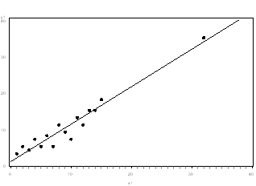
Should we remove the outlier?

Slide 18
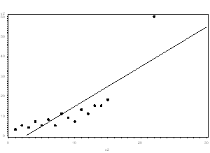
Should we remove the outlier?

Slide 19
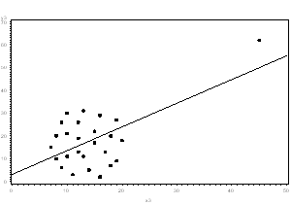
Should we remove the outlier?

Slide 20
How to remove outliers
The simplest method of removing outliers relies on removing data that is "far away" from the median.
We do this by using quartiles.
Quartiles are a method of dividing datasets. Using the median you divide the dataset into 2. From these 2 datasets you can create 2 more medians and divide the dataset further. The median of the upper list is called the upper quartile, and the median of the lower list is called the lower quartile.

Slide 21
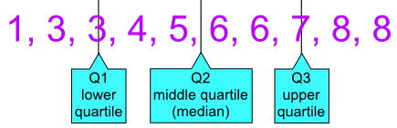
Quartiles Continued
A simple but common way to remove outliers is to throw away anything above the upper quartile, and everything below the lower quartile.
Side note: Subtracting the lower quartile from the upper quartile gives us the interquartile range, which is another measure of how "spread out" a data set is.

Slide 22
Data Integrity
Measures like the median, standard deviation, and interquartile range are meaningless if we cannot trust the data used to generate them.
Going back to the Mexican vs Italian debate, we can’t as ALL Americans their food preferences so we only ask sample sizes. We collect several samples and create a dataset of all the sample results we receive. From there you create a list of standard deviations from each sample. Using these standard deviations, you can compare how “far away” a particular sample is from the population. This is called the standard error. Each sample's standard error describes how far its mean is from the population's "true" mean.

Slide 23
Student’s t-test
One powerful tool for determining if two sample means represent the same population is Student's t-test. Student's t-test can only be used to test two sample means against each other.
For this housing data, we would have to use multiple t-tests — we would test high vs mid; high vs low; and mid vs low.
The t-test takes two data sets and returns something called a t statistic, and a p value.
t statistic - tells us how likely it is the differences are significant. The higher the t-statistic, the higher the chances they are significant.
p value – if p < 0.05, we should assume that the differences are not due to change.

Slide 24
Regression
Measures like the median, variance, and IQR describe data sets, but do not allow us to make predictions with it. Regression allows us to reverse engineer the equations that describe our data. It is tools like regression that allow us to predict where data points we did not measure might end up if we had collected more data.

